Slide 1
Business & Financial Plan for Youth Social Enterprise Investment ian ki-hoon suh

Slide 2

Business Description
The name of the Business/Organization will be Youth Social Enterprise Investment.
The Business will be a social Enterprise aim
Notes:
The business will be called Youth Social Enterprise Investment and the type of business will be a social enterprise. The main aim of starting the business will be to ensure that the Youth in the community will be helped to start u their own business for the purpose of empowering them and the community around them. In the target community, the main problem is the youth lacking funds and mentorship, for the business ideas they have. In turn it will be able to affect various aspects of life, like living standards. The idea is mainly a social enterprise, but profitability will also be factored to make the business sustainable.

Slide 3
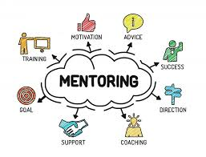
Service Provided
Mentorship programs
Financial Help
Monitoring the progress of the Startups.
Notes:
The business will mainly concentrate in the mentoring of youth who have business ideas and they want to venture in but lack the require support to fully start and lead the business.. The process is social and economical because there will be the giving of small loans and at the same time interacting with the youths. Additionally, the business will also be monitoring the progress of the startups in order to see the one which are succeeding and the ones which are struggling in order to see what can be done to improve them.

Slide 4

Target Market
The Target Market with be the youths who will include both genders.
Investors
The Local community
Notes:
The business majorly targets youths in the community who are struggling to establish themselves and make an impact in the community they come from. There are a majority of people who want to make changes in the world but they lack the necessary ability or help to do so. Additionally my business will be geared towards looking for investors for the young people with the business ideas but lack the connection to get people to invest.

Slide 5

Business Objective
Facilitating Youth Empowerment
Creating Gender Equality
Notes:
Your business objectives are the results you hope to achieve as you run and grow your business. For the Youth empowerment and gender equality among the youths who are the future of the community and society. As an entrepreneur, you are concerned with every aspect of your business and need to have clear goals in mind for your company if you are to stay on track. Having a comprehensive list of business objectives creates the guidelines that become the foundation for your business planning.

Slide 6

Enterprise Goals
Ensuring that there are more Youth businesses.
Provide better customer service.
Increase profit margin for future support of youth enterprises.
Provide more employment.
Notes:
The enterprise has several objectifies that it intends to achieve. Since it is a funds, mentorship programs for the young people as well as monitoring the progress they are making in order to calculate the success rate of the business. With the enterprises owed by the young people they will be able to provide more job opportunities to the community members, increase profit margins, offer better customer service, and capture a bigger market share.

Slide 7
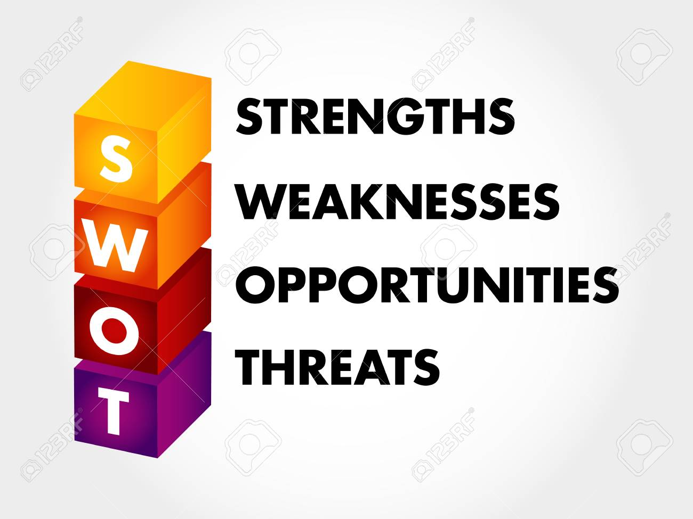
SWOT Analysis
The Social Entrepreneur business Strengths
The Weakness which are there.
The Available Opportunities
The Threats which will come along.
Notes:
The SWOT analysis is an instrumental part of a business as it helps in knowing what the strength, weaknesses, available opportunities, and the threats likely to be faced. It is an instrumental tool for every business as it defines what might be expected from the business and the surrounding environment.

Slide 8

SWOT Analysis: Strengths
Capital strength
Active Management
Strong Basis and background experience in the field of Social Enterprise
Notes:
The enterprise will continuously be maintaining a strong capital base. There is a large number of investors that have show interest in the business idea and have promised to support all the processes. Non-governmental organizations have also promised to be part of the Business as they are invested in uplifting the young people in the community. The entire management team of the business will be aggressive and remain focused on the business goal. The management team will be selected by a professional human resource team to ensure a positive mentality is maintained.

Slide 9

SWOT Analysis: Weaknesses
Lack of enough Trust from the Investors.
Lack of confidence and determine due to the competition from big companies.
Capital for starting up
The Youth may lack enough knowledge of running or staring a business.
Notes:
Most of the employees that the enterprise will hire will have robust experience in social entrepreneurship but at the same time they will lack trust from the investors as it will be a new business being started. The other weakness will be the lack of confidence or losing hope from the business clients (young people) when the times get hard when venturing into the business. The capital for starting the business is also another thing which is a weakness.

Slide 10

SWOT Analysis: Opportunities
Employment
Growth of the Community
Improved living Standards
Activism
Self-help
Donors
Notes:
The enterprise will consider having activists to assist in pushing for activities and making the business know to the community members. There is the increase in number of activism groups that agitate for better living standards and provoke the action of national and local governments in coming together in making the community grow. The livelihood of people standards will grow as the business started by the young people will be making job available for many and in doing so bettering lives.

Slide 11

SWOT Analysis: Threats
Adverse political and economic environment
Stiff Competition
Technological weaknesses
Notes:
Some of the political and economic environments might affect the enterprise especially on capital acquisition. There are lot of political wrangles in the locality and there are political leaders that do not support the idea of social enterprises because they think that they take advantage of the local communities. Additionally, there are several enterprises with activities in the areas hence posing threat to the enterprise. The enterprise might lack the necessary technology to reach out to the youths in the community and making the monitoring of the startup hard.

Slide 12

Initial Financials: Initial Capital
Donors
Savings
Family input
First year and second year start up capital of $500,000
Notes:
The enterprise will have an initial capital of $500,000 that is intended to help the business for the first and second year of investments. Various investors have shown interest in the idea and they expected to raise roughly $300,000. the funds will cover the cost of licenses and permits for the business. The remaining $200,000, half of it will be raised from my personal saving and inputs from family members. The investors expect their money to be paid back plus profits one the agreed period is over. Additionally, the enterprise will be aggressive in looking for private donors to donate more capital to the business. Donors do not need their monies to be repaid and they reduce the debt burden on the enterprise.

Slide 13

Initial Financials: Expenditure
Rent
Utilities
Employees’ Salaries
Training
Taxes
Marketing
Notes:
Since it’s a start up business, the enterprise projects to incur several expenditures including rent, utilities, employees’ salaries, training, taxes, and marketing. All these expenditures are primary in business organization for it to thrive. Ignoring them will negatively affect the growth of the enterprise and it may fail offer sustainable products and services to the target market. More capital will be allocated to the marketing department to ease the process of looking for new business partners and customers. Once these two are found and retained the market for the product grows exponentially.

Slide 14

Initial Financials: Assumptions
An interest rate of 15%
Availability of a Favorable economy
Availability of donors
No economic crisis
Notes:
Assumptions had to be made when it comes to Finance issues. Several assumptions have been made when coming up with the initial financials of the enterprise. First, the enterprise assumes that the economy will be favorable so that all activities are carried out. The enterprise also assumes that the interest rate will be ranging around 15% for the first two tears. Lastly, factors like increased inflation have not been included and once they occur the enterprise will be negatively affected. Additionally, it assumes that there will be many donors available in the local community. Donors will aid in raising the required funds and help in distribution of the product.

Slide 15

Initial Financials: Depreciation Cost
Low depreciation
Need to change the office equipment.
Notes:
For the first two years, the depreciation cost is predicted to be low to the extend of being insignificant. There are machinery to be bought at the start of the enterprise. They include the office equipment such as tables, chairs, printers, filling cabinets, and computers. These products depreciate after a certain period of time and when the enterprise may think of replacing or repairing them the price will not be the same. Initially, in the first two years, the replacement or repair cost may be high and negatively affect the financial performance of the company. However, after four years the enterprise will be thriving and the costs will not be high.

Slide 16

Target Labor Force
Local Community Youths
Individual with knowledge of running a business.
Social workers who better know the community
Notes:
Since the enterprise will serve the local community, there is need to involve the community members in the process of implementation. Once the local people are involved, they will be loyal to the product because it supports their economic growth and their livelihoods. The enterprise targets the youths will the community to be the first source of labor force because they are energetic. Also the business will incorporate individual with social work skills as well as those who know how to run business from scratch

Slide 17

Staffing
Management
Social Workers/Mentors
Monitoring officers
Training Team
Notes:
The staff of the enterprise will include management team that will coordinate all the activities from the identification of potential youth to nature and help in coming u with their businesses. All these people need to coordinate to ensure that the process is sustainable and meets the highest standards required to run the enterprise.

Slide 18
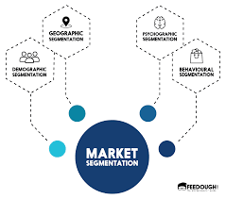
Market Segmentation
The business market is segmented toward the young generation.
Notes:
The have one segment. The young people are the one who are the future of the community and the business aimed is to empowered them no matter their gender. The business ideas they have will be used to improve and uplift the community.

Slide 19


Funding Model and Scalability Plan & Stakeholder Benefits
External funding
Yearly subscription
Subsidized prices
Notes:
For the first two years of operation, the business will much depend on external funding, these are mainly investors and donors. A company has to operational before it receives any funds from government institutions and that is why the company has not factored the government as a financier. The youths from the community will be persuaded to become stakeholders and they will be giving donation to the business in order to help in supporting other young people.
When in comes to the Stakeholders benefits, the Members of the enterprise will accrue some benefits including subsidized prices.

Slide 20
References
Berry, T. (2020, January 2). A Standard Business Plan Outline [Updated for 2020] | Bplans. Bplans Blog. https://articles.bplans.com/a-standard-business-plan-outline/
III, G. N., & Thompson, J. (2019, January 29). 10 Most Important Business Objectives. Retrieved from Chron: https://smallbusiness.chron.com/10-important-business-objectives-23686.html
SWOT Analysis. (2019, July 2). REDFworkshop. https://redfworkshop.org/tool/swot-analysis/
Sector, F. (2007). A business planning guide for developing a social enterprise. Dalam www. forthsector. org. uk.

